Slide 1
Using variant auto encoder for reconstructing images
Yael Berger
July 2019

Slide 2

Deep convolution inverse graphics networks (2015)
C
Tejas D. Kulkarni (MIT), Will Whitney (MIT),
Pushmeet Kohli (Cambridge),Joshua B. Tenen(MIT)

Slide 3


How do we see?
VS.

Slide 4
How do we see?
VS.

Slide 5
“vision as inverse graphics” model
Computer graphics consists of a function:
input: compact descriptions of scenes (the graphics code) -> output: images
typically disentangled to allow for rendering scenes with fine-grained control over transformations such as object location, pose, lighting, texture, and shape.
This encoding is designed to easily and interpretably represent sequences of real data so that common transformations may be compactly represented in software code.

Slide 6
Deep convolution inverse graphics networks
Motivation: Can a deep NN learn to disentangle factors of image generation such as lighting, rotation, etc.? (characterizing the optimal representation of the data)
Can we learn a renderer?

Slide 7
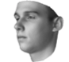
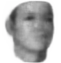
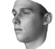
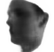
DC-IGN
Generate transformed images w.r.t rotations, light variations, etc.
Input: 2D image (150 x 150 pixels)
Output: new generated images of the same object with variations in pose and lighting
Learn latent variables that represent complex transformations
Use an encoder-decoder structure based on VAE
rotation
light variation

Slide 8
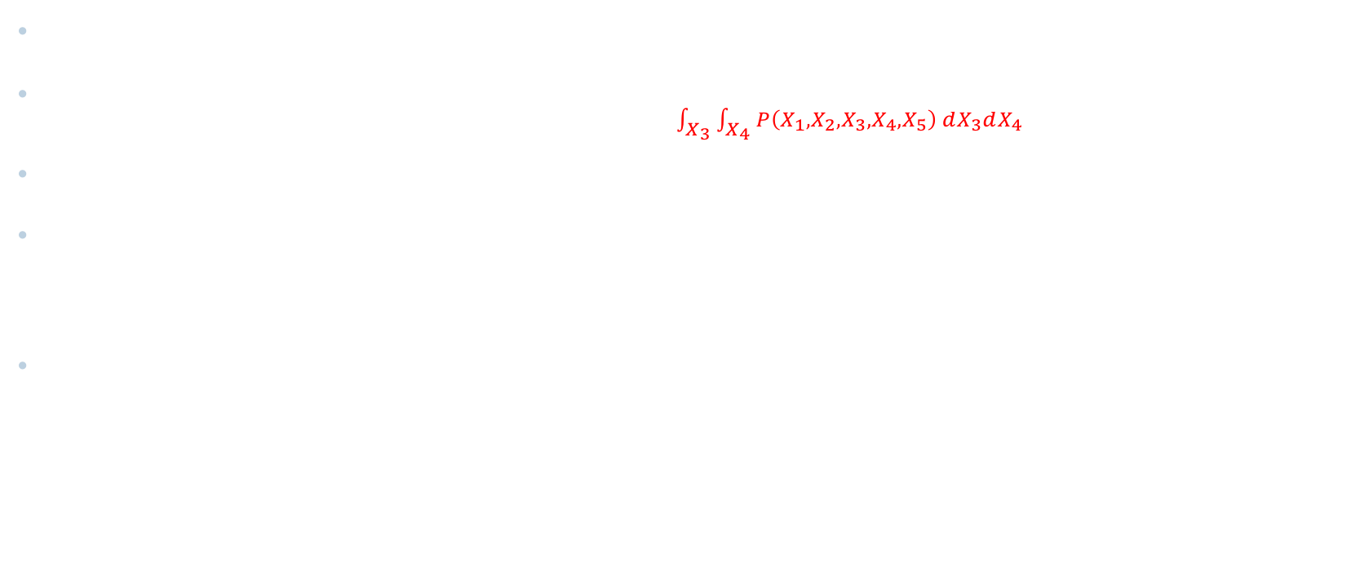
Recap: VAE model
Joint PDF: P(X_{1,..,5})=P(X₅|X₃)P(X₄|X₂,X₃)P(X₃|X₁)P(x₂|X₁)P(X₁)$→$ easy
Conditional distribution: P(X₃ ,X₄ |X₁, X₂,X₅)=$\frac{P\left(X_{1},X_{2},X_{3},X_{4},X_{5}\right)}{\int_{X_{3}}{\int_{X_{4}}{P\left(X_{1},X_{2},X_{3},X_{4},X_{5}\right)} dX_{3}dX_{4}}}→$ hard
$P\left(X_{1},X_{2},X_{3},X_{4},X_{5}\right)$ $→$ P(X₃ ,X₄ |X₁, X₂,X₅) ?
P(Z|X)=$\frac{P\left(X,Z\right)}{P(X)} →$use q(Z) instead of P(Z|X) to approximate it
KL+L = $−Σ_{Z}q\left(Z\right)\log{\frac{P\left(Z | X\right)}{q\left(Z\right)}}+Σ_{Z}q\left(Z\right)\log{\frac{P\left(X,Z\right)}{q\left(Z\right)}}$ = ln P(Z|X)
known
Unknown(difficult to calculate)
can be changed by picking q(Z)
fixed, given
Notes:
KL convergence - distance between two probability distributions

Slide 9


Recap: VAE model
KL+L = $−Σ_{Z}q\left(Z\right)\ln{\frac{P\left(Z | X\right)}{q\left(Z\right)}}+Σ_{Z}q\left(Z\right)\ln{\frac{P\left(X,Z\right)}{q\left(Z\right)}}$ = ln P(Z|X)
maximize
Assume Z={$z_{1}$, $z_{2}$, $z_{3}$}, X={$x_{1}$, $x_{2}$, $x_{3}$}
L = $Σ_{z_{1}}Σ_{z_{2}}Σ_{z_{3}}q\left(z_{1},z_{2}, z_{3}\right)\ln{\frac{P\left(x_{1}\text{, }x_{2}\text{, }x_{3},z_{1},z_{2}, z_{3}\right)}{q\left(z_{1},z_{2}, z_{3}\right)}}=Σ_{z_{1}}Σ_{z_{2}}Σ_{z_{3}}q\left(z_{1}\right)q\left(z_{2}\right)q\left(z_{3}\right)[ln{P\left(X,Z\right)−\ln{q\left(z_{1}\right)−lnq\left(z_{2}\right)−lnq\left(z_{3}\right)] }}$

Slide 10
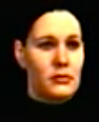
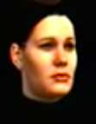
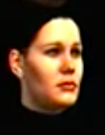
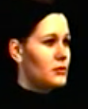
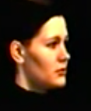
Training Data Set
Single 3D face
different pose and lighting
Different types of data
Affine transformation
Why?
forces chosen neurons in the graphics code layer to specifically represent active transformations → automatically creating a disentangled representation
Light
Texture
Shape

Slide 11
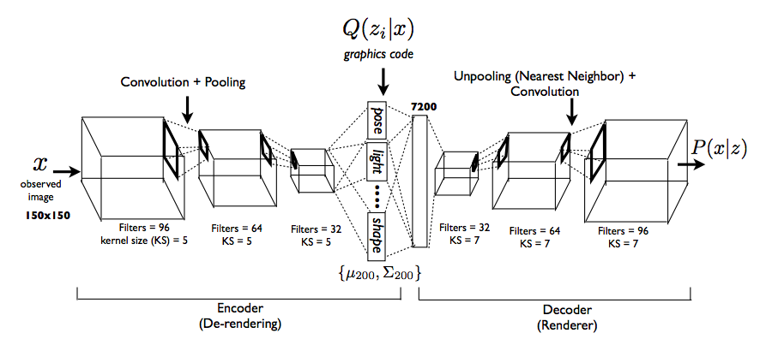
Model Architecture
captures distribution over distribution over graphics codes
Variational autoencoder architecture with variations
The DC-IGN model is composed of multiple layers of convolution and de-convolution operators and is trained using the stochastic gradient variational Bayes algorithm

Slide 12
Encoder
x
Q(z_{i}|y_{e})
Q is chosen to be a multivariate normal distribution.
data
captures distribution over distribution over graphics codes Z - disentangled representation containing a factored set of latent variables z_{i}∈Z such as pose, light and shape.

Slide 13
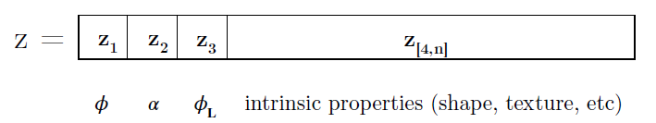
graphics codes z - latent variables
rotation of the object
variations of the light source
elevation of the object with respect to the camera
disentangled representation containing a factored set of latent variables z_{i}∈Z
Notes:
In this model, latent variables are represented as graphics codes z that determine the properties of images.
DC-IGN generates new images by changing one of these three variables.

Slide 14

Latents Z - capturing distribution over distribution over graphics codes Z
Encoder output: $y_{e}=encoder\left(x\right)$
Model parameter: $W_{e}$
Distribution parameters: $θ=\left(μ_{z_{i}},Σ_{z_{i}}\right)$
$$μ_{z_{i}}=W_{e}∗y_{e}$$
$$Σ_{z_{i}}=diag\left(\exp\left(W_{e}∗y_{e}\right)\right)$$
$$∀i,z_{i}\sim N\left(μ_{z_{i}},Σ_{z_{i}}\right)$$
We use back-propagated using stochastic gradient descent
variational objective function: −log(P(x|z_{i})) + KL(Q(z_{i} |x)||P(z_{i})) $∀$ z_{i}
Notes:
DC-IGN follows the basic structure of VAE. Using the encoder output and model parameter, the distribution parameters of latent variables are parametrized using multivariate Gaussian.
And, to learn the parameters, the model optimizes this variational objective function.

Slide 15

Training with a Specific Transformation
training with only one transformation at a time$→$ encourages certain neurons to contain specific information
we also wish to explicitly discourage them from having other information $→$ we train all the neurons which correspond to the inactive transformations with an error gradient equal to their difference from the mean.
pointing to a close-together but not identical point in a high-dimensional space; the invariance training signal will push them all closer together.
Notes:
This training procedure works to train both the encoder and decoder to represent certain properties of the data in a specific neuron. By clamping the output of all but one of the neurons, we force the decoder to recreate all the variation in that batch using only the changes in that one neuron’s value. By clamping the gradients, we train the encoder to put all the information about the variations in the batch into one output neuron.

Slide 16
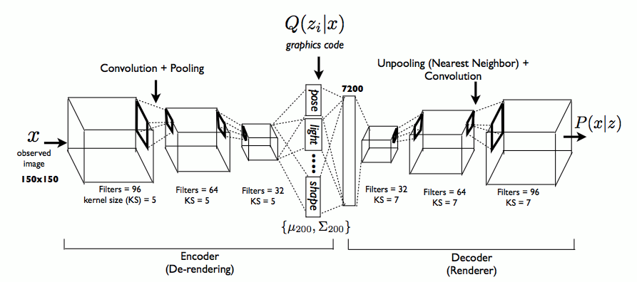

Decoder
The decoder network learns a conditional distribution to produce an approximation $\hat{x}$ given Z.
It is a function that transform a compact graphics code ( 200 dimensions) to a 150x150 image.
It has several layers of unpooling (upsampling using nearest neighbors) followed by convolutionto handle the massive increase in dimensionality with a manageable number of parameters.
It is perhaps surprising that the fully-trained decoder network is able to function as a 3D rendering engine.

Slide 17
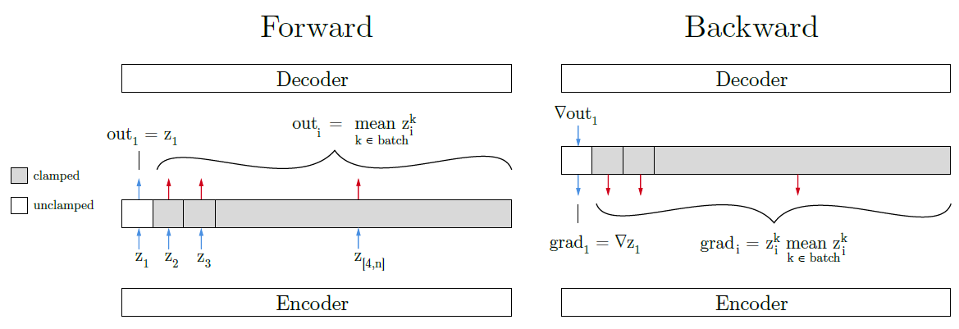
DC-IGN
Training on a minibatch in which only one extrinsic property changes i.e. Only a specific latent variable changes
Key Idea: Force all other latent variables to be same across examples – Force all of them to be close to the minibatch mean
Notes:
We need to pick one latent variable that mutates a certain extrinsic property.
During the forward step, the output from each component z_i != z1 of the encoder is altered to be the same for each sample in the batch.
By holding these outputs constant throughout the batch, the single neuron z1 is forced to explain all the variance within the batch, i.e. the full range of changes to the image caused by changing z1.
During the backward step, z1 is the only neuron which receives a gradient signal from the attempted reconstruction, and all z_i receive a signal that is closer to their respective averages over the batch.
During the complete training process, after this batch, another batch is selected at random; it likewise contains variations of only one of z_k ; all neurons which do not correspond to the selected latent are clamped ; and the training proceeds.

Slide 18
So?
Images can be re-rendered to different viewpoints, lighting conditions, shape variations etc by just manipulating the appropriate graphics code group (zi), which is how one would manipulate an off the shelf 3D graphics engine.

Slide 19
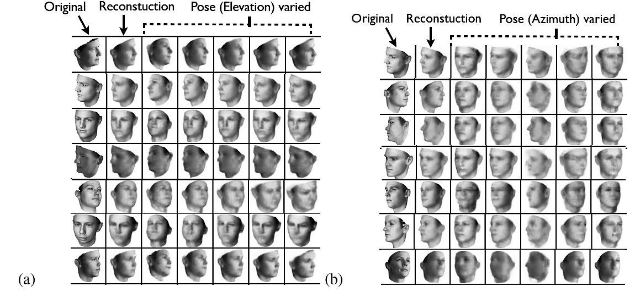
Generation w.r.t. manipulation of pose variables
(a) Elevation. (b) rotation of the face

Slide 20
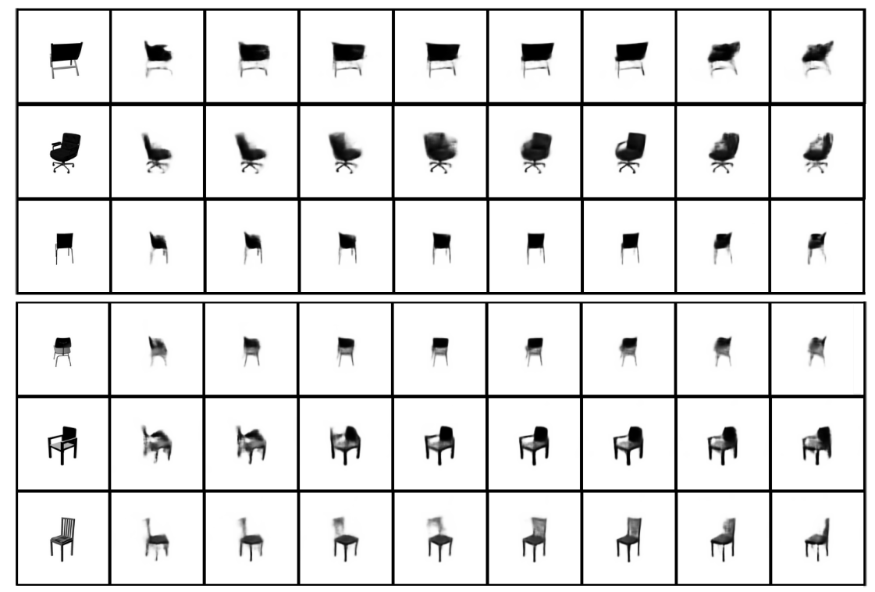
Manipulate rotation for a different dataset (chair dataset)

Slide 21

We train this representation using SGVB, but we make some key adjustments to the outputs of the encoder and the gradients which train it. The procedure is as follows:
Select at random a latent variable z_{train} which we wish to correspond to one of {azimuth angle, elevation angle, azimuth of light source, intrinsic properties}.
Select at random a mini-batch in which that only that variable changes.
Show the network each example in the minibatch and capture its latent representation for that example z k .
Calculate the average of those representation vectors over the entire batch.
Before putting the encoder’s output into the decoder, replace the values zi $≠$z_{train} with their averages over the entire batch. These outputs are “clamped”.
Calculate reconstruction error and backpropagate as per SGVB in the decoder
Replace the gradients for the latents zi $≠$z_{train} (the clamped neurons) with their difference from the mean. The gradient at z_{train} is passed through unchanged.
Continue backpropagation through the encoder using the modified gradient

Slide 22
Learning Single-View 3D Object Reconstruction without 3D Supervision (2016)
C
Xinchen Yan(UMICH), Jimei Yang(Adobe Research), Ersin Yumer(Adobe Research), Yijie Guo(UMICH), Honglak Lee((UMICH), Google)

Slide 23
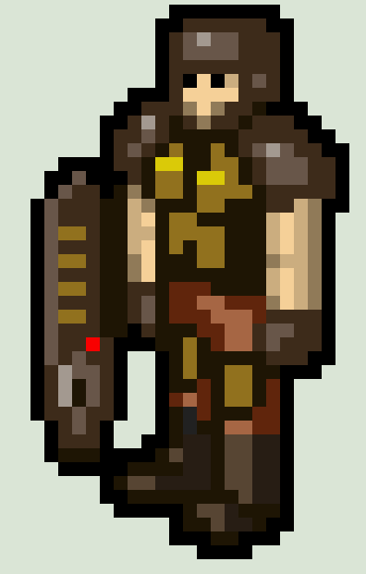
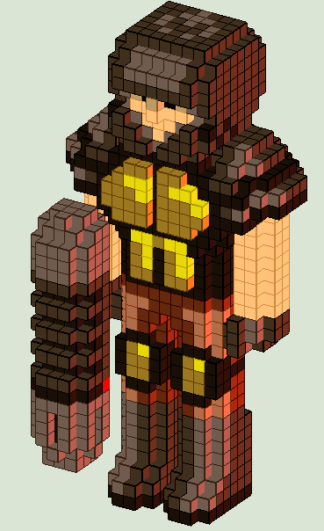
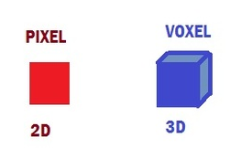

Pixel -> Voxel
We’ll use Volumetric representation of 3D shape V where
voxel $V_{i}=\{\begin{matrix}1 \text{i}\text{t} \text{is} \text{occupied} \text{by} \text{the} \text{shape} \\ 0 o.w.\end{matrix}$.

Slide 24
Learning Single-View 3D Object Reconstruction without 3D Supervision
A learning agents (neural networks) should involve the following properties:
the agent should understand the physical meaning of how a 2D observation is generated from the 3D shape
the agent should be conscious about the outcome of its interaction with the object; more specifically, by moving around the object, the agent should be able to correspond the observations to the viewpoint change
Then the agent will be able to disentangle the shape from the extrinsic factors(e.g lighting)

Slide 25
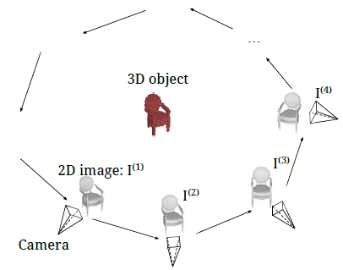

Problem : Understanding 3D object from learning agent’s perspective
$I^{(k)}$is the 2D image from k-th viewpoint $α^{(k)}→$by projection $I^{(k)}$= P(X; $α^{(k)}$)
Notes:
An object X in a certain scene is the entanglement of shape, color and texture (its intrinsic properties) and the image $I^{(k)}$ is the further entanglement with viewpoint and illumination (extrinsic parameters). The general goal of understanding 3D objects can be viewed as disentangling intrinsic properties and extrinsic parameters from a single image.
A learning agents (neural networks) should involve the following properties:
the agent should understand the physical meaning of how a 2D observation is generated from the 3D shape
the agent should be conscious about the outcome of its interaction with the object; more specifically, by moving around the object, the agent should be able to correspond the observations to the viewpoint change

Slide 26
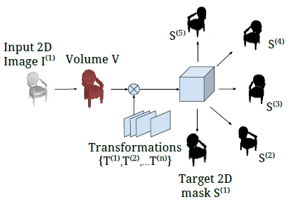
Problem : Single-view 3D volume reconstruction with perspective transformation
Notes:
An object X in a certain scene is the entanglement of shape, color and texture (its intrinsic properties) and the image $I^{(k)}$ is the further entanglement with viewpoint and illumination (extrinsic parameters). The general goal of understanding 3D objects can be viewed as disentangling intrinsic properties and extrinsic parameters from a single image.
A learning agents (neural networks) should involve the following properties:
the agent should understand the physical meaning of how a 2D observation is generated from the 3D shape
the agent should be conscious about the outcome of its interaction with the object; more specifically, by moving around the object, the agent should be able to correspond the observations to the viewpoint change

Slide 27
Assumptions on the input
We focus on the 3D shape learning by ignoring the color and texture factors, and we further simplify the problem by making the following assumptions:
the scene is clean white background;
the illumination is constant natural lighting.

Slide 28



Rendering Image Process
Case 1 we know the ground truth 3D volume $V$
Loss function L_{vol}($I^{\left(k\right)}$) = ${\left|\left|f\left(I^{\left(k\right)}\right)−V\right|\right|}_{2}^{2}$.
encoder
decoder
learns a viewpoint-invariant latent representation h($I^{\left(k\right)}$)
generates the 3D volume $\hat{V}$ = g(h($I^{\left(k\right)}$)).
However, ground truth volume may not be available in practice

Slide 29
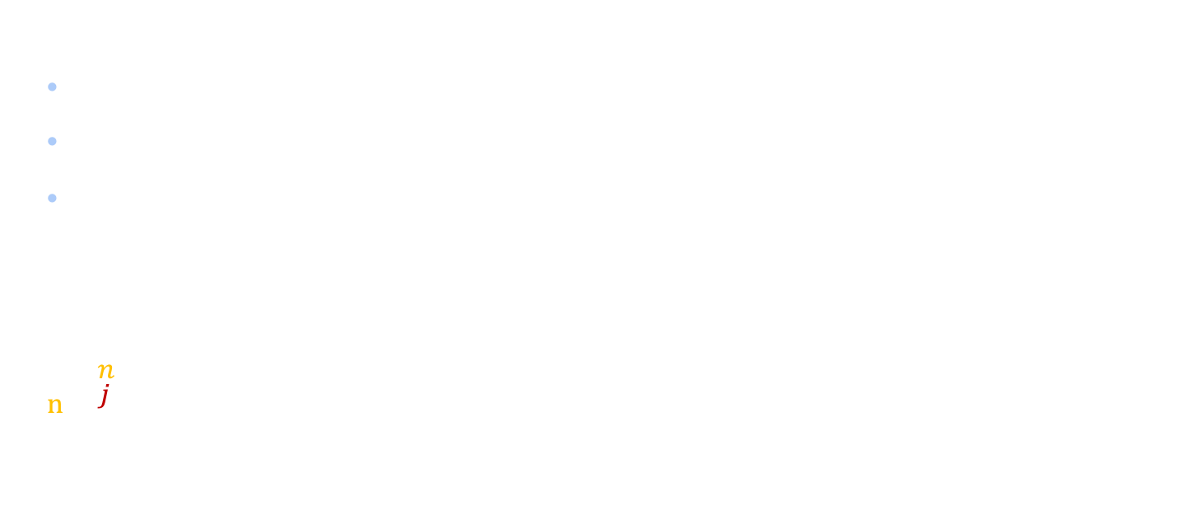
Rendering Image Process
Case 2 we do NOT know the ground truth 3D volume $V$
Use 2D silhouette images
$S^{(j)}$: ground truth 2D silhouette image for the j-th viewpoint $α^{\left(j\right)}$
${\hat{S}}^{(j)}$: generated silhouettes P($f\left(I^{\left(k\right)}\right)$, $α^{\left(j\right)}$)
Loss function: $L_{proj}\left(I^{\left(k\right)}\right)$= $\sum_{j=1}^{n}{L_{proj}^{(j)}}\left(I^{\left(k\right)}\text{; }S^{\left(j\right)}\text{, }α^{\left(j\right)}\right)$ = $\frac{1}{n}\sum_{j=1}^{n}{{\left|\left|\text{P}\text{(}\text{f}\text{(}I^{\left(k\right)}\text{); }α^{\left(j\right)}\text{) − }S^{\left(j\right)}\right|\right|}_{2}^{2}}$
the index of output 2D silhouettes
number of silhouettes used for each input image
P(·) is the 3D-2D projection function
General learning objective $:L_{comb}\left(I^{\left(k\right)}\right)={λ_{proj}L}_{proj}\left(I^{\left(k\right)}\right)$+ ${λ_{vol}L}_{vol}\left(I^{\left(k\right)}\right)$
${λ_{proj},λ}_{vol}$ -constants that control the tradeoff between the two losses.

Slide 30
The neural network
object image (2D observation)
predicts
volumetric 3D shape
1) image encoder
2) volume decoder
3) perspective transformer
The neural networks are able to predict 3D shape from single-view without using the ground truth 3D volumetric data for training. This is made possible by introducing a 2D silhouette loss function based on perspective transformations.
We train a single network for multi-class 3D object volumetric reconstruction and show its generalization potential to unseen categories.

Slide 31
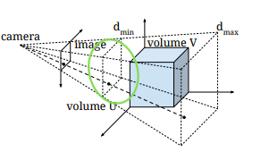

Perspective Transformer Nets
How to obtain 2D silhouette ${\hat{S}}^{\left(j\right)}$- perspective projection
$θ_{4x4}=\left[\begin{matrix}K & 0 \\ O^{T} & 1\end{matrix}\right]\left[\begin{matrix}K & t \\ O^{T} & 1\end{matrix}\right]$
K is camera calibration matrix ,
(R, t) is extrinsic parameters
$$∀p_{i}^{s}=\left(x_{i}^{s},y_{i}^{s},z_{i}^{s},1\right) (3D coordinates)→\text{screen} \text{coordinates}\text{: }p_{i}^{t}=\left(x_{i}^{t},y_{i}^{t},z_{i}^{t},d_{i}^{t}\right)$$
How? By using the perspective transformation $p_{i}^{s}$ ${∼θ}_{4x4} p_{i}^{t}$
Notes:
disparity: the difference in image location of the same 3D point when projected under perspective to two different cameras

Slide 32
Perspective Transformer Nets
Use spatial transformer network (Jaderberg et al. NIPS 2015)
(1) Perform dense sampling from input volume in 3D coordinates
to output volume in screen coordinates
(2) Flatten the 3D spatial output across disparity dimension.
Yan et al., Perspective Transformer Nets, NIPS 2016

Slide 33
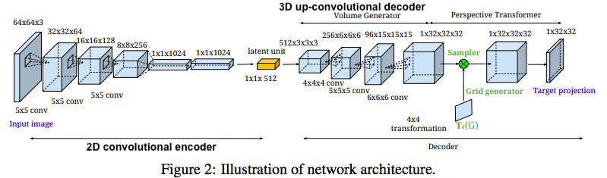
Model Architecture
ShapeNetCore Dataset - contains about 51,300 unique 3D models from 55 common object categories [1]. Each 3D model is rendered from 24 azimuth angles (with steps of 15◦ ) with fixed elevation angles (30◦ ) under the same camera and lighting setup. We then crop and rescale the centering region of each image to 64 × 64 × 3 pixels.
Notes:
our encoder-decoder network has three components: a 2D convolutional encoder, a 3D up-convolutional decoder and a perspective transformer networks. The 2D convolutional encoder consists of 3 convolution layers, followed by 3 fully-connected layers (convolution layers have 64, 128 and 256 channels with fixed filter size of 5 × 5; the three fullyconnected layers have 1024, 1024 and 512 neurons, respectively). The 3D convolutional decoder consists of one fully-connected layer, followed by 3 convolution layers (the fully-connected layer have 3 × 3 × 3 × 512 neurons; convolution layers have 256, 96 and 1 channels with filter size of 4 × 4 × 4, 5 × 5 × 5 and 6 × 6 × 6). For perspective transformer networks, we used perspective transformation to project 3D volume to 2D silhouette where the transformation matrix is parametrized by 16 variables and sampling grid is set to 32 × 32 × 32. We use the same network architecture for all the experiments.

Slide 34
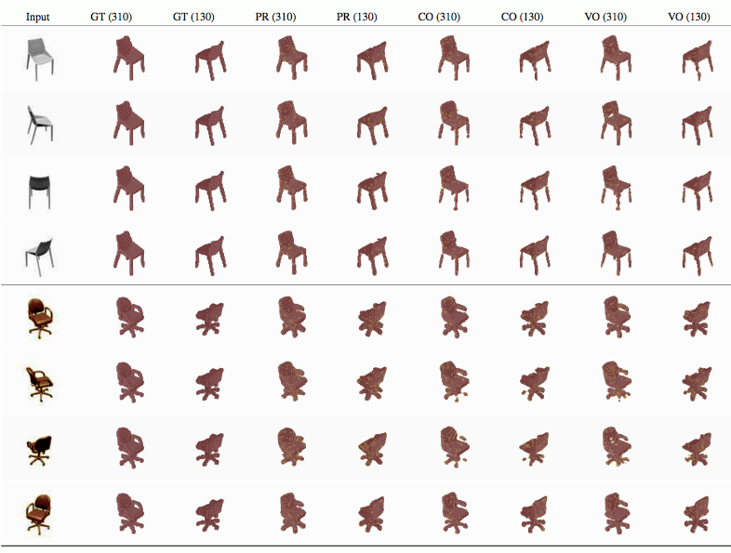
Training on single category
$L_{comb}\left(I^{\left(k\right)}\right)={λ_{proj}L}_{proj}\left(I^{\left(k\right)}\right)$+ ${λ_{vol}L}_{vol}\left(I^{\left(k\right)}\right)$
The volumes predicted by PTN-Proj and PTN-Comb faithfully represent the shape. However, the volumes predicted by CNN-Vol do not form a solid chair shape in some cases.
PTN-Proj (PR) - the model trained with projection loss only
CNN-Vol (VO)- the model trained with volume loss only
PTN-Comb (CO)- combined loss
Notes:
Compared to training with full azimuth angles, we demonstrate comparatively similar results when training with partial views.

Slide 35
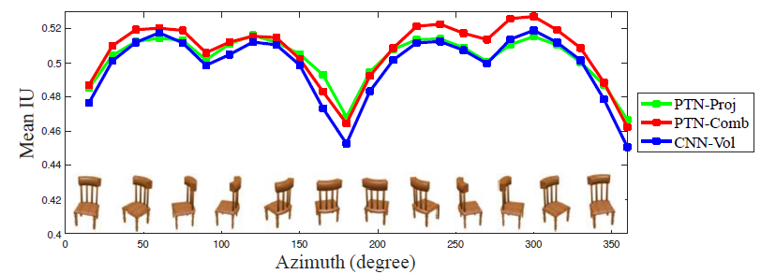
Training on single category
Yan et al., Perspective Transformer Nets, NIPS 2016
Notes:
Chair considers full rotation angles. Chair-N considers some range of angles (15 degree)

Slide 36
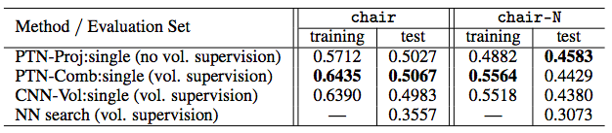
Training on single category
PTN-Proj (PR) - the model trained with projection loss only
CNN-Vol (VO)- the model trained with volume loss only
PTN-Comb (CO)- combined loss
observable with full azimuth angles
narrow range (subset) of azimuth angles
Notes:
Compared to training with full azimuth angles, we demonstrate comparatively similar results when training with partial views.

Slide 37
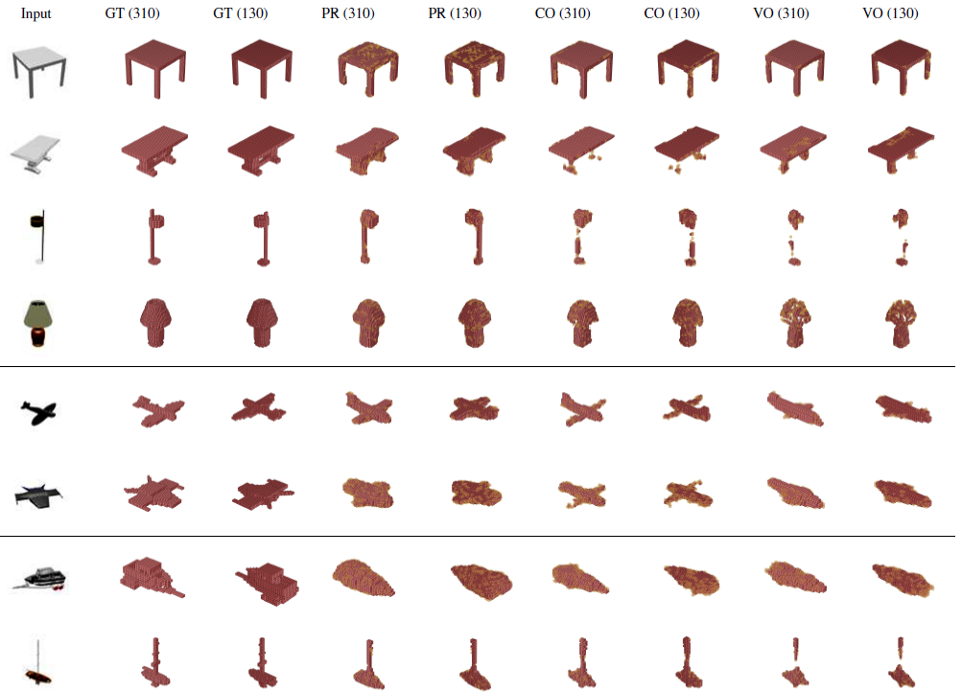
large-scale datasets

Slide 38
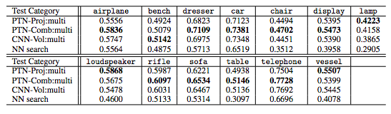
Prediction IU using the models trained on large-scale datasets

Slide 39
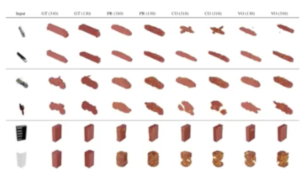
Out f category datasets

Slide 40
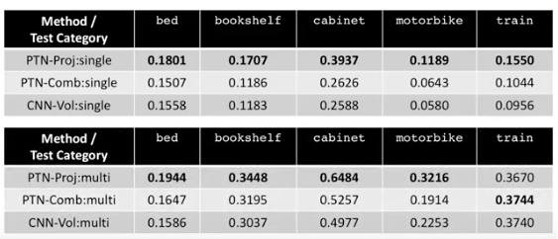
Prediction IU

Slide 41
Summary

Slide 42
Bibliography
http://cs231n.github.io/convolutional-networks/
Unsupervised Learning of Invariant Feature Hierarchies with Applications to Object Recognition
Variational Inference Tutorial, Chieh Wu, NEU
Deep Convolutional Inverse Graphics Network
Perspective Transformer Nets: Learning Single-View 3D Object Reconstruction without 3D Supervision
Max Planck Institute for Intelligent Systems
Geoffrey Hinton: "Does the Brain do Inverse Graphics?”, video
3D + Graphics by Qi Zhu & Juho Kim
Vision as Inverse Graphics by Vinjai Vale, MIT PRIMES CS conference
Capsule Networks As a New Approach to Image Recognition

